Slide 1

UNIVERSITY INSTITUTE OF COMPUTING
Agile Methodology
(24CAT-656)

Slide 2
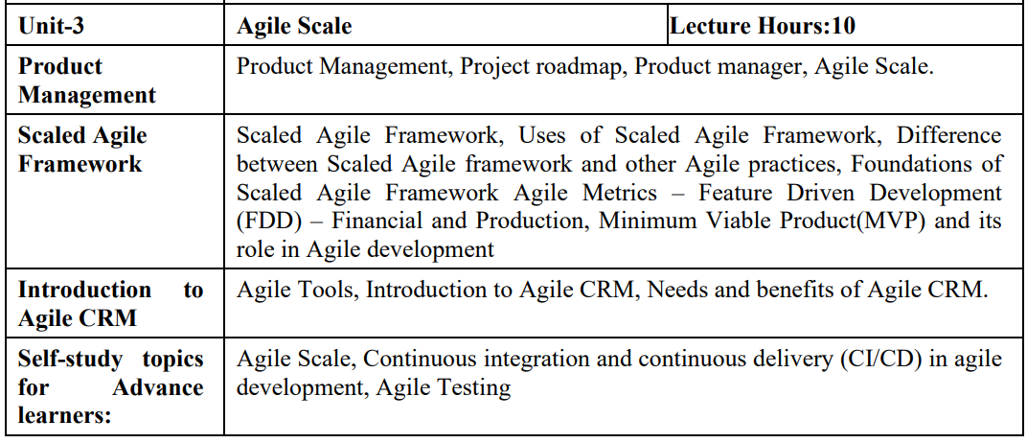
SYLLABUS
2

Slide 3
CONTENT OF THE SYLLABUS
TEXT BOOKS
T1 David J. Anderson and Eli Schragenheim, Agile Management for Software Engineering: Applying the Theory of Constraints for Business Results, Prentice Hall, 2003.
T2 Hazza and Dubinsky, Agile Software Engineering, Series: Undergraduate Topics in Computer Science, Springer, 2009.
T3 Agile Software Development Ecosystems by Jim Highsmith, Addison-Wesley 2002, ISBN 0201760436.
REFERENCES
R1 Craig Larman, Agile and Iterative Development: A Managers Guide, Addison-Wesley, 2004.
R2 Kevin C. Desouza, Agile Information Systems: Conceptualization, Construction, and Management, Butterworth-Heinemann, 2007.
3

Slide 4

Katalon TestOps rovides an agile workspace for your team. TestOps gives testing and DevOps teams a clear, connected picture of their tests, resources, and environments to run the right test, in the right environment, at the right time.
Enhance collaboration and transparency through comments, dashboards, KPI tracking, actionable insights.
Streamlined result collection through robust failure analysis and reporting capabilities across any framework.
Real-time data tracking for accurate debugging through comprehensive test reports.
4

Slide 5

Monday.com is one of the best agile project management tools available in the market. It offers a clean interface with color-coded features. This easy-to-use software is suitable for big or small teams. It also offers a user-friendly mobile app and highly customizable workflows.
Features:
You can integrate it with your existing tools and get more things done in less time.
It allows you to collaborate with your team in one shared workspace.
Provides colored timelines and options to sync timelines with the calendar.
It offers highly customizable workflows.
Helps you to bring your team together, anywhere, and anytime.
It provides a map view for location-based projects.
5

Slide 6

Click Up is a highly customizable agile project management tool that allows you to create your custom views. This agile project management tool offers highly comprehensive time management and task management and facilitates collaboration between business units
Features:
You can filter and search for a specific task with ease.
It offers a wide range of templates.
Helps you to automatically import documents from other apps.
Allows you to collaborate with other people.
It allows you to assign multiple tasks with just one mouse click.
ClickUp enables you to sort tasks by project.
You can sync with Google Calendar.
6

Slide 7

Sprints is a tool that helps you to manage your team and product with ease. It enables you to track your progress with no hassle. This software can be used to find bottlenecks and discover ways to generate business value.
Features:
It is integrated with CI/CD tools.
This tool helps you to get product feedback with ease.
Allows you to work on any device and place.
Enables the team to comment on code changes.
7

Slide 8

Bug Shooting is a useful tool for software developers as well as agile testing. It provides an easy way to create screen captures and attach them to items of bug tracking or issue management system for reporting bugs.
Features:
Support for Intelligent capture mode
Create professional graphics by adding effects to screenshots
Easy and fast access to frequently used tools
It can automatically store the captured screenshots
8

Slide 9

Snagit is a popular screenshot capturing tool. It provides powerful tools to edit, annotate and share screenshots. It can also be used to submit and push screenshots directly.
Features:
This agile testing tool offers complete features for screen capture and video recording
Capture videos with a simple, intuitive screen recorder
Capture a website, record an online meeting or send feedback in an email
9

Slide 10

JIRA is a defect tracking tool which is used for Agile testing as well as project management. This tool is not only used for recording, reporting but also integrated with code development environment.
Features:
JIRA Query Language helps to create quick filters with a single click
This agile tool help your team become more accurate and efficient
Reporting functionality gives team critical insight into their agile process
Extensive reporting functionality gives your team critical insight into their agile process.
Allows creating custom workflows of any size which is helpful to build, test, and release software
10

Slide 11

SoapUI is an agile testing tool for service-oriented architectures (SOA) and REST. Its functionality includes web service inspection, invoking, development, functional testing, and load testing.
Features:
It is open-source testing tool
This agile tool offers Drag and Drop Test Creation
It allows reusing functional test cases and security scans in just a few clicks
It Supports Data-Driven Testing
Multi Environment Support
Allows service Simulation
Static Content Mocking
11

Slide 12

The Apache JMeter application is an open-source agile performance testing tool. It is used to load functional test behaviour and measure performance of the website.
Features:
Ability to load and performance test different applications/server and protocols
Full featured Test IDE for fast Test Plan recording
This agile tool offers complete portability and 100% Java purity
Data analysis and visualization plugins offers great extensibility
Functions can be used to offer dynamic input to test or provide data manipulation
Easy Continuous Integration using third party libraries for tools like Maven, Gradle, and Jenkins
12

Slide 13

Selenium WebDriver is an automation agile testing tool. It aims to mimic the behavior of a real user, and as such interacts with the HTML of the application.
Features:
It is a compact Object Oriented API
This agile tool Support different languages like Java, Python, Ruby, Perl, PHP, and Javascript
Selenium server initializing is not required
WebDriver finds any coordinates of any object
It is easy tool for a WebDriver to build a keyword driven framework
13

Slide 14
THANK YOU
For Queries:- ramanjeetsingh.uic@cumail.in

